Slide 1
The future of work & education
BGKLLEN presentation 30 March 2022

Slide 2
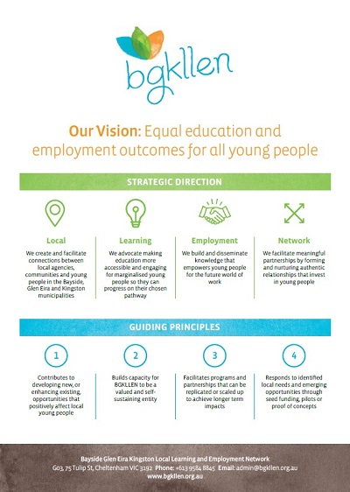
https://www.weforum.org/agenda/2020/10/what-to-expect-from-the-jobs-reset-summit/

Slide 3
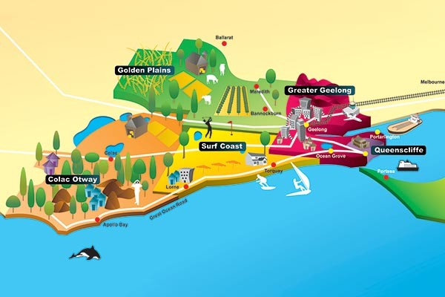
What is a labour market?
Need to understand labour markets from an economic, social and geographic viewpoint
A geographic viewpoint = regions

Slide 4
What is a region?
“Regional Cities, which have populations of over 50,000 persons. They have diverse economies and the chance to use their size and diversity to shape their own future.
Connected Lifestyle Regions do not have city population size but are close to our major metropolitan regions. They will be influenced by their connection with these cities.
Industry and Service Hubs are regional centres with between 15,000 – 50,000 residents, located further from major metropolitan areas. Their performance is linked to industry outcomes, but their population size means they could be resilient to change.
Heartland Regions are smaller regional areas that are not close to other major metropolitan or Regional Cities. Industry trends and local ingenuity will shape their future.” (p. 3)
Regional Australia Institute, 2014, Talking Point: The Foundations of Regional Australia, http://www.regionalaustralia.org.au/wp-content/uploads/2014/12/Foundations-of-regional-Australia-FINAL-.pdf
Capital cities = metropolitan regions

Slide 5
Labour economics

Slide 6
Labour economics
Neo-classical
(economic rationalist)
The labour market is a social as well as an economic institution and the interaction between human beings cannot be interpreted in the same way as the supply and demand for dead fish
Hutchens, G. 2021 Lift the minimum wage and employment still rises? How to anger the establishment and win a Nobel Prize

Slide 7
Labour economics
Neo-classical
Radical
(power relationships)

Slide 8
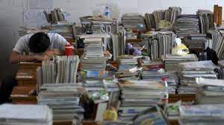
Labour economics
Neo-classical
Radical
Institutional (ME)
(people = messy)

Slide 9
New models of thinking

Slide 10
New models of thinking - UN/OECD 2030 Sustainable Development Goals
SDG 4 – “ensure inclusive and equitable quality education and lifelong learning for all”,
SDG 8 – “Promote sustained, inclusive and sustainable economic growth, full and productive employment and decent work for all”
SDG 11 – “Make cities inclusive, safe, resilient and sustainable”
“a world in which equity, inclusion and a healthy environment are assured for everyone”
Lifelong Learning a “guiding principle for building more sustainable cities and achieving the 2030 Agenda”
Also the Earthshot prize – environmental focus
https://earth.org/prince-william-launches-50-million-earthshot-prize/?gclid=Cj0KCQjwuMuRBhCJARIsAHXdnqPSyO9odfd9Ok_9kR613aSihkx85CQoM3TrlzQf8A_cIQrOVQkOKIMaAiDhEALw_wcB

Slide 11
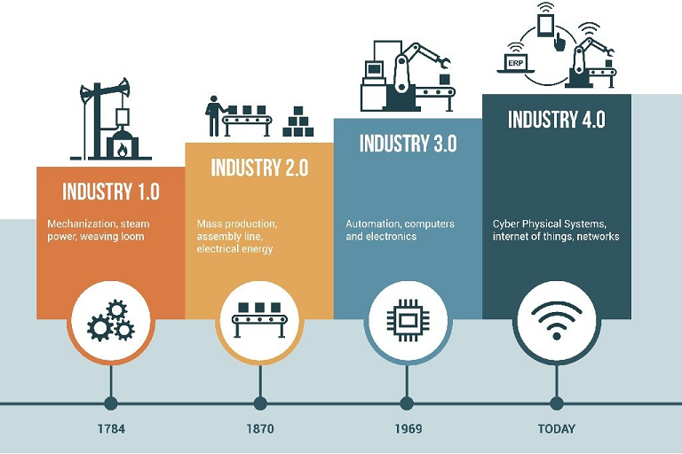
New models of thinking - Changing Nature of Work and Learning – Industry 4.0
The fourth industrial revolution, Industry 4.0 - embedding smart, connected technology & transforming our economies, jobs and societies.

Slide 12
New models of thinking - Changing Nature of Work and Learning
OECD: robotics and artificial intelligence replacing 57% of jobs across member countries.
WEF and OECD “automation redefining jobs”.
WEF: reskilling revolution
Education 4.0 focus on lifelong and life wide learning responding to the challenges of Industry 4.0.

Slide 13
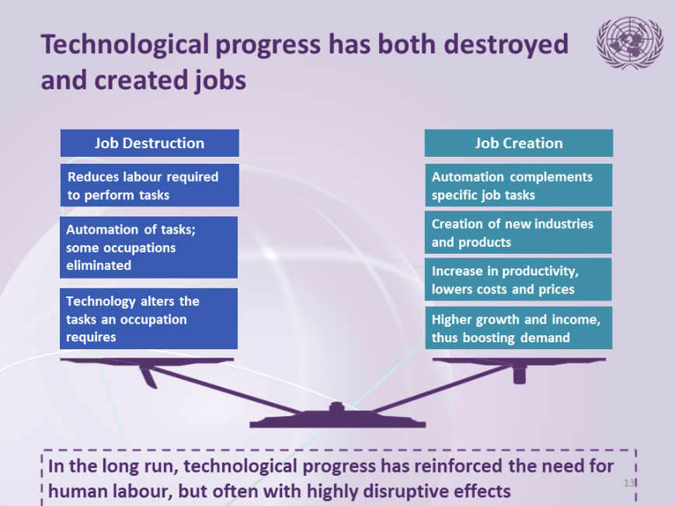
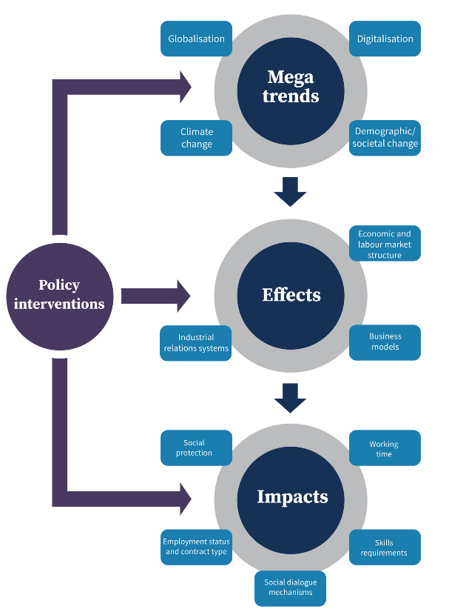
Changing nature of labour markets
Impact of new technologies
Structural changes

Slide 14
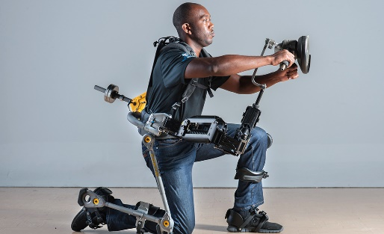
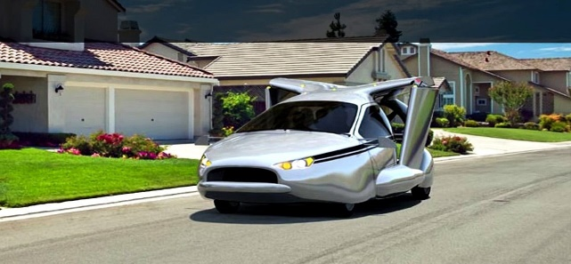
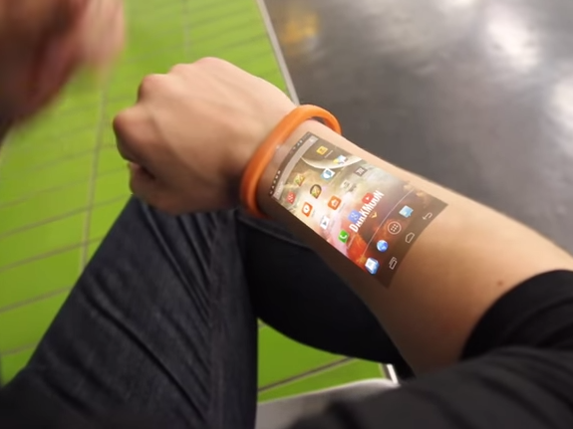
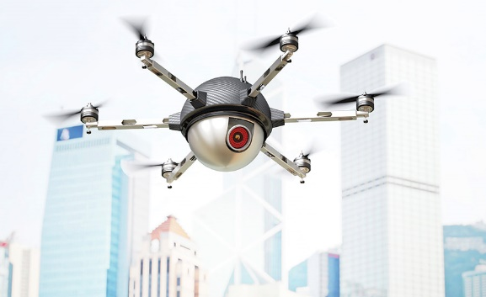

Slide 15
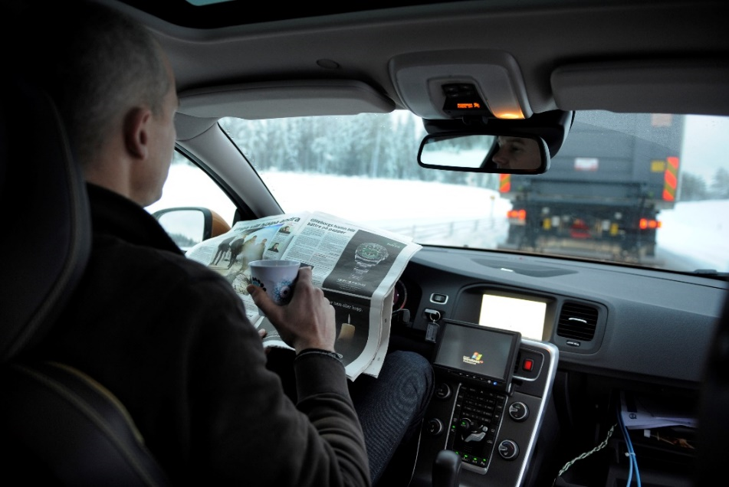
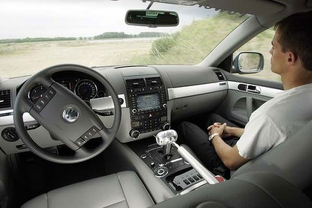
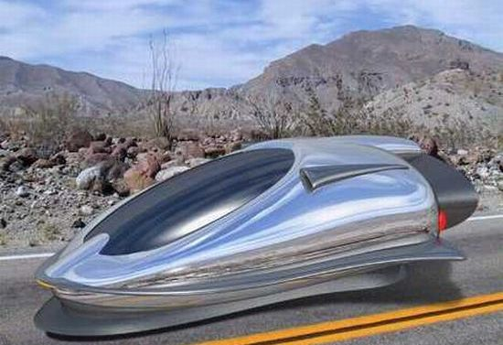
Trend 1 - automation
Transport

Slide 16
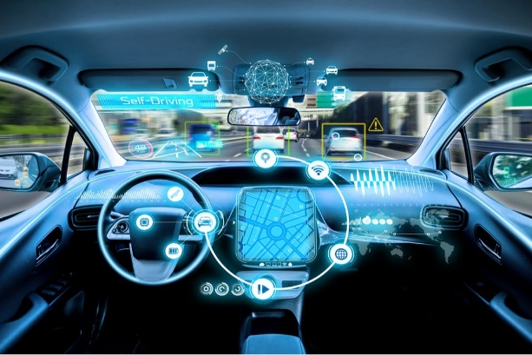
Trend 1 - automation
Automobile Transportation – Going Driverless
New Jobs Created
Delivery dispatchers
Traffic monitoring systems, although automated, will require a management team.
Automated traffic designers, architects, and engineers
Driverless “ride experience” people.
Driverless operating system engineers.
Emergency crews for when things go wrong.

Slide 17
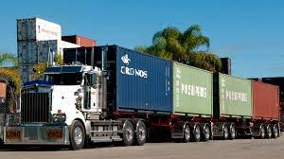
Trend 1 - automation
Automobile Transportation – Going Driverless
Jobs Going Away
Taxi and limo drivers, gone.
Bus drivers, gone.
Truck drivers, gone.
Gas stations, parking lots, traffic cops, traffic courts, gone.
Fewer doctors and nurses will be needed to treat injuries.
Pizza (and other food) delivery drivers, gone.
Mail delivery drivers, gone.
Courier delivery jobs, gone.
As people shift from owning their own vehicles to a transportation-on-demand system, the total number of vehicles manufactured will also begin to decline.

Slide 18
The Australian Labour Market
ANZSIC
19 divisions
subdivisions
groups
classes
Division | C | Manufacturing
Subdivision | 11 | Food Product Manufacturing
Group | 111 | Meat and Meat Product Manufacturing
Class | 1111 | Meat Processing

Slide 19
The Australian Labour Market
ANZSCO
8 Major Groups
Sub-major groups
Minor groups
Unit groups
Occupations
Skill levels
1 | MANAGERS
 | 11 | Chief Executives, General Managers and Legislators
 |  | 111 | Chief Executives, General Managers and Legislators
 |  |  | 1111 | Chief Executives and Managing Directors
 |  |  |  | 111111 | Chief Executive or Managing Director

Slide 20
Jobs which are most at risk from automation over the next two decades?
Library technicians Clerks Telemarketers Restaurant cooks Farm labourers Dental technicians Machine setters Cashiers Real estate brokers Couriers | Agricultural technicians Bookkeepers Legal secretaries Drivers Sales workers Credit analysts Umpires/referees Insurance appraisers Loan officers Welders

Slide 21
What do we know about the Australian labour market? – Trend 1
Advances in automation and computerisation mean that:

Slide 22
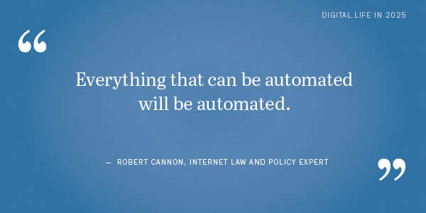
What do we know about the Australian labour market? – Trend 1
Advances in automation and computerisation mean that:
40%, or 5 million, jobs are at high risk from automation in the Australian labour market by 2030
CEDA, 2015, Australia’s Future Workforce, p. 58
http://www.regionalaustralia.org.au/home/regional-job-automation-pack/

Slide 23
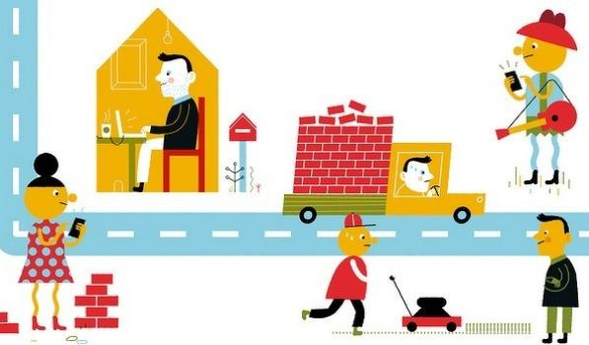
2. Structural changes - The rise of the “gig”, “portfolio” or “sharing” economy

Slide 24
What do we know about the Australian labour market? - Trend 2

Slide 25
What do we know about the Australian labour market? – Trend 2

Slide 26
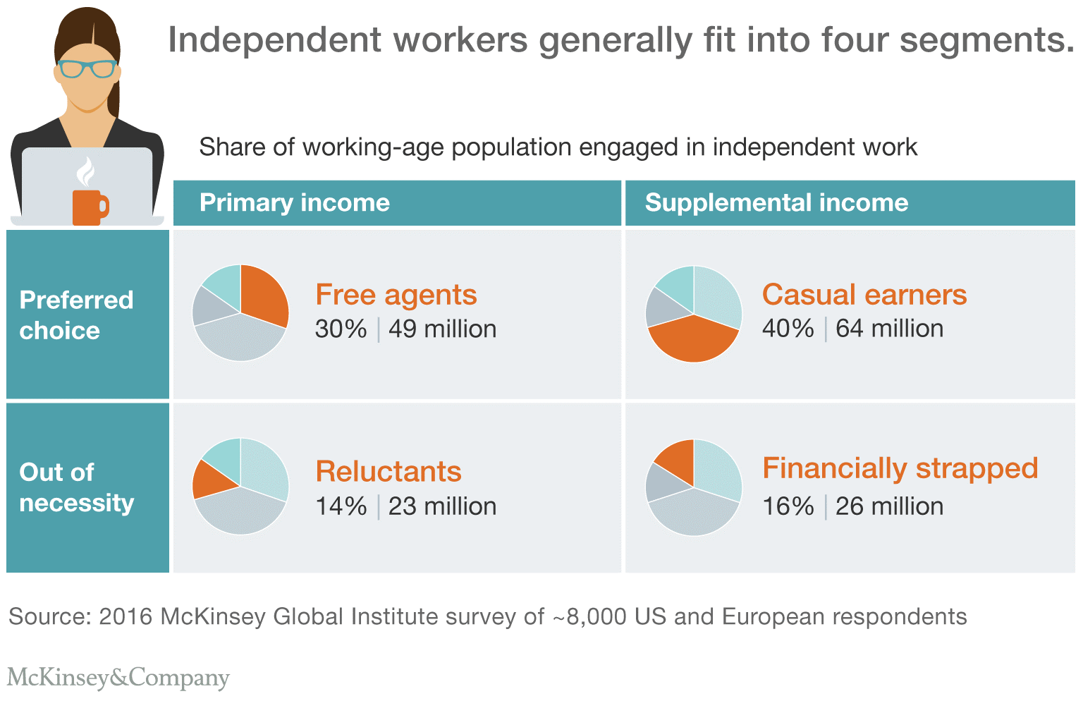
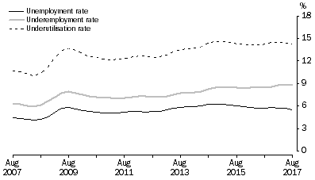
What do we know about the Australian labour market? - Trend 2
Total = approx. 30%
http://www.abs.gov.au/ausstats/abs@.nsf/Latestproducts/6202.0Main%20Features2Aug%202017?opendocument&tabname=Summary&prodno=6202.0&issue=Aug%202017&num=&view=

Slide 27
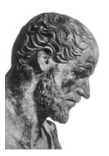
What does this mean for the education system?
384-322BC

Slide 28
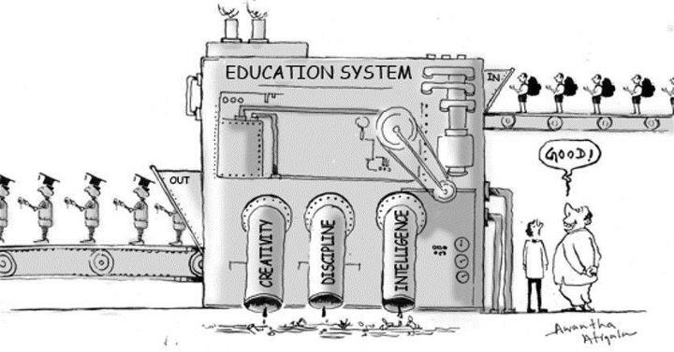
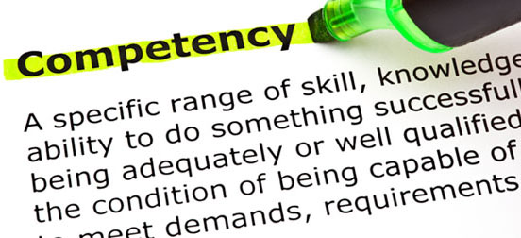
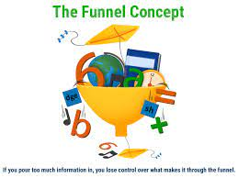
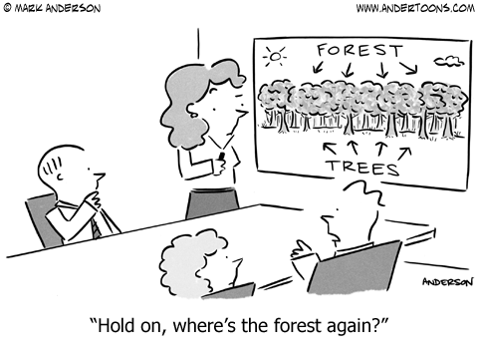
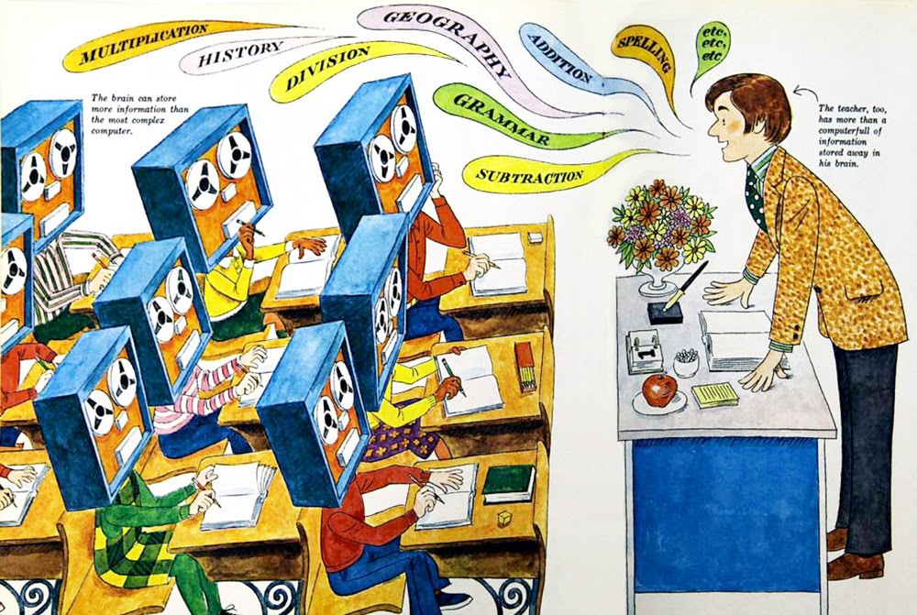

Slide 29
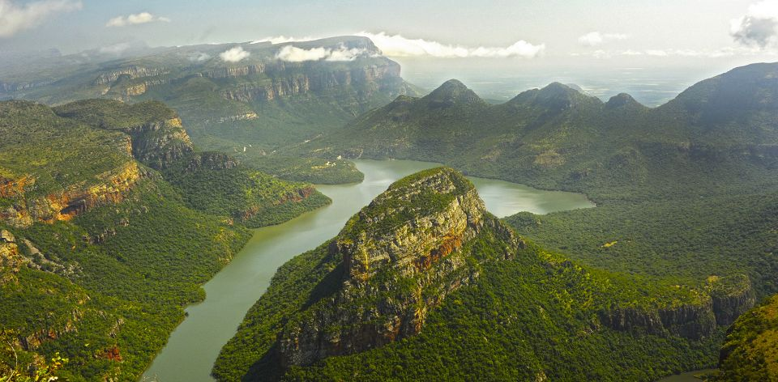
Neuroplasticity

Slide 30
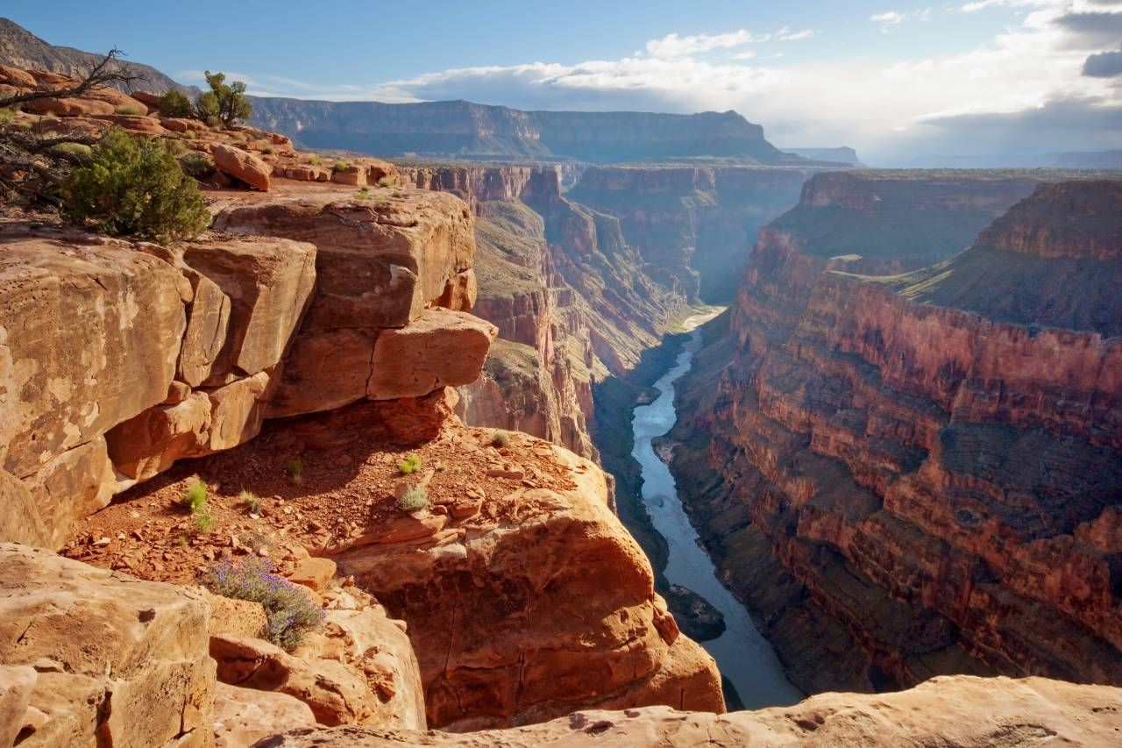

Slide 31
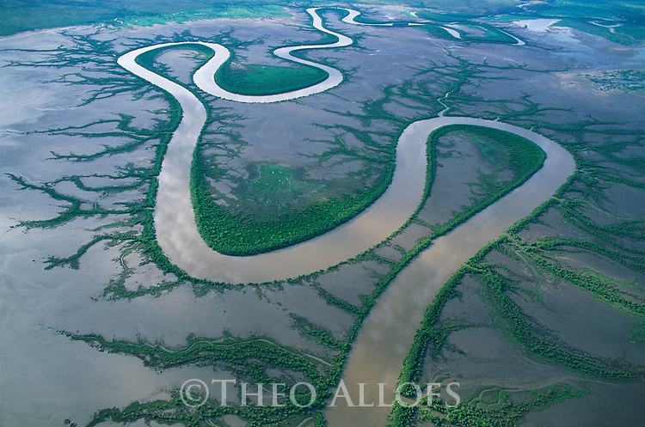
Neuroplasticity

Slide 32
The Torrance Test of Creative Thinking
In the past, the test has shown that 98% of children in kindergarten are “creative geniuses”
by age 25, only 3% remain creative geniuses
over the last 25 years, the Torrance Test has shown a decrease in originality among young children (kindergarten to grade 3)
https://www.weforum.org/agenda/2017/09/skills-children-need-work-future-play-lego/

Slide 33
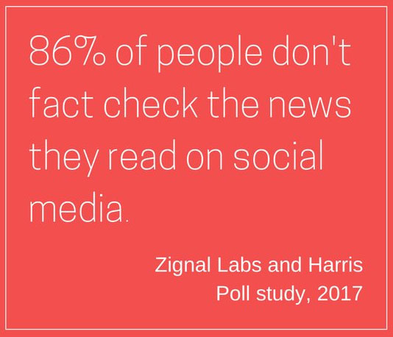

Slide 34
The Cogitaire 5 Model
Futures
Thinking
Systems
Thinking
The
Cogitaire 5
Model
Design
Thinking
Complexity
Thinking
Entrepreneurial
Thinking
Developed by Dr. Jude Walker, 2017

Slide 35
Evidence based practice - Data

Slide 36
Regional Development
ABS Census +++ abs.gov.au
Table Builder Regional data
Number of businesses by industry - at 30 June
Data available for years: 2016, 2017, 2018, 2019, 2020
Description | 2020 (Bayside (C)) | 2020 (Glen Eira (C)) | 2020 (Kingston (C) (Vic.))
Agriculture, forestry and fishing (no.) | 157 | 84 | 107
Mining (no.) | 12 | 11 | 11
Manufacturing (no.) | 282 | 359 | 1 169
Electricity, gas water and waste services (no.) | 21 | 24 | 68
Construction (no.) | 1 626 | 1 987 | 3 142
Wholesale trade (no.) | 502 | 656 | 1 250
Retail trade (no.) | 721 | 952 | 1 123
Accommodation and food services (no.) | 436 | 643 | 642
Transport, postal and warehousing (no.) | 291 | 1 006 | 1 192
Information media and telecommunications (no.) | 182 | 210 | 119
Financial and insurance services (no.) | 2 050 | 1 922 | 1 420
Rental, hiring and real estate services (no.) | 1 875 | 2 567 | 1 930
Professional, scientific and technical services (no.) | 3 006 | 2 987 | 2 176
Administrative and support services (no.) | 469 | 698 | 712
Public administration and safety (no.) | 30 | 44 | 35
Education and training (no.) | 296 | 300 | 280
Health care and social assistance (no.) | 1 107 | 1 354 | 759
Arts and recreation services (no.) | 264 | 282 | 234
Other services (no.) | 415 | 547 | 944
Currently unknown (no.) | 21 | 27 | 30
Number of businesses by industry - total | 13 760 | 16 677 | 17 349
Overall number of businesses in BGKLLEN in 2020 |  |  | 47786

Slide 37
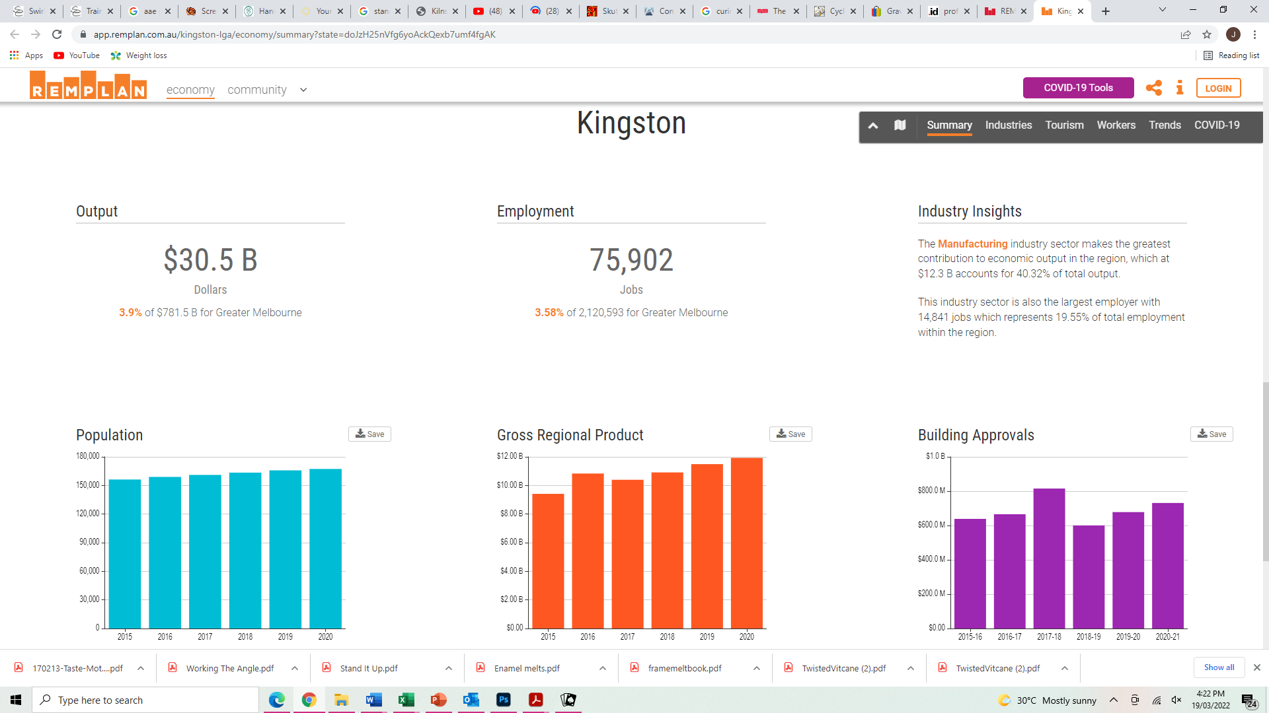
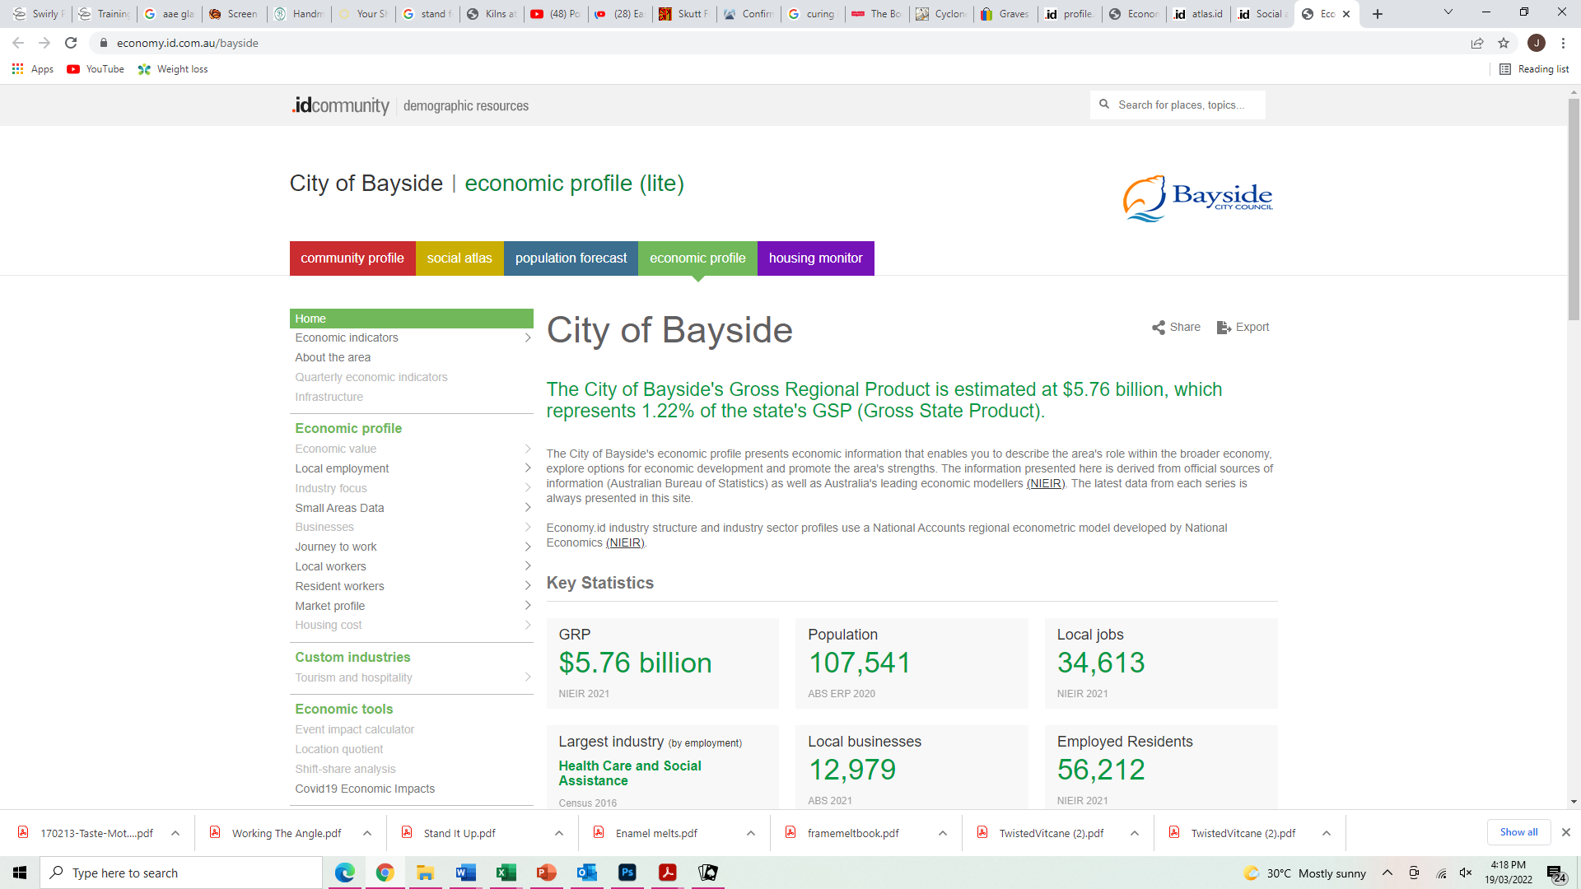
Local data
REMPLAN
Profile.id

Slide 38
Regional Development
http://www.regionalaustralia.org.au/home/regional-job-automation-pack/

Slide 39
Regional Development
Regional Australia Institute (regionalaustralia.org.au)
[In]sight

Slide 40
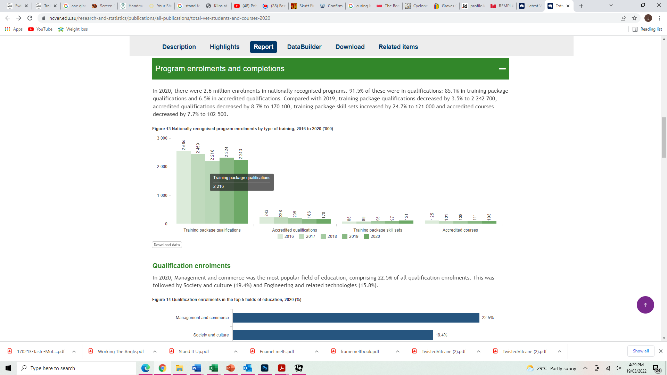
NCVER

Slide 41
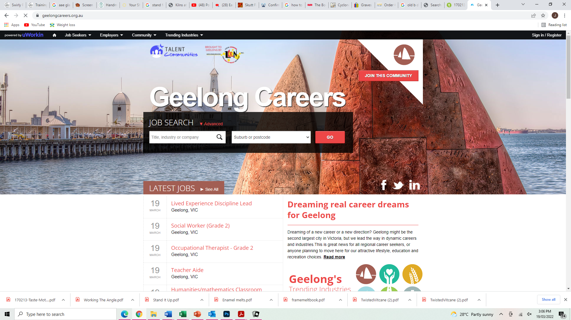
Regional Development
https://geelongcareers.org.au

Slide 42
Some light reading – future of work
http://www3.weforum.org/docs/WEF_Jobs_of_Tomorrow_2020.pdf
https://business.linkedin.com/content/dam/me/business/en-us/talent-solutions/emerging-jobs-report/AUS-TOP-EMERGING-JOBS_compressedRevised.pdf
https://100jobsofthefuture.com/report/

Slide 43
Some light reading – future of education
https://education.unimelb.edu.au/mgse-industry-reports/report-1-those-who-disappear
http://www3.weforum.org/docs/WEF_Schools_of_the_Future_Report_2019.pdf

Slide 44
Questions/comments?
Email: jwalker@futureworking.com.au
Twitter: @JudeWalker2
LinkedIn: linkedin.com/in/jude-walker-65438577

