Slide 1
Engaging vulnerable and disengaged students with learning
David Roycroft
Elissa Douglas
www.oakwoodschool.vic.edu.au

Slide 2
Oakwood School
was established to provide learning opportunities for students aged
10 to 18 who
have disengaged from school.

Slide 3
Australian research from the 1990’s found that
of 14 years olds are estimated to be
3%
absent from school on a long-term basis or not enrolled at all.
In 2016 the Australian Institute of Health and Welfare found that of people aged 15–19 (75,300 people) were not engaged in education and/or employment.
5.1%

Slide 4
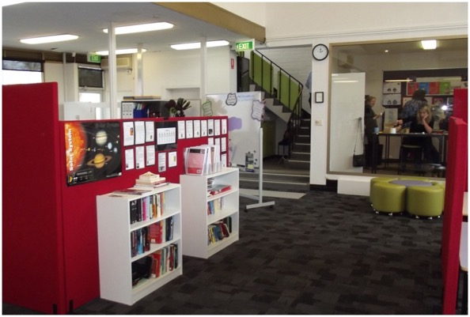
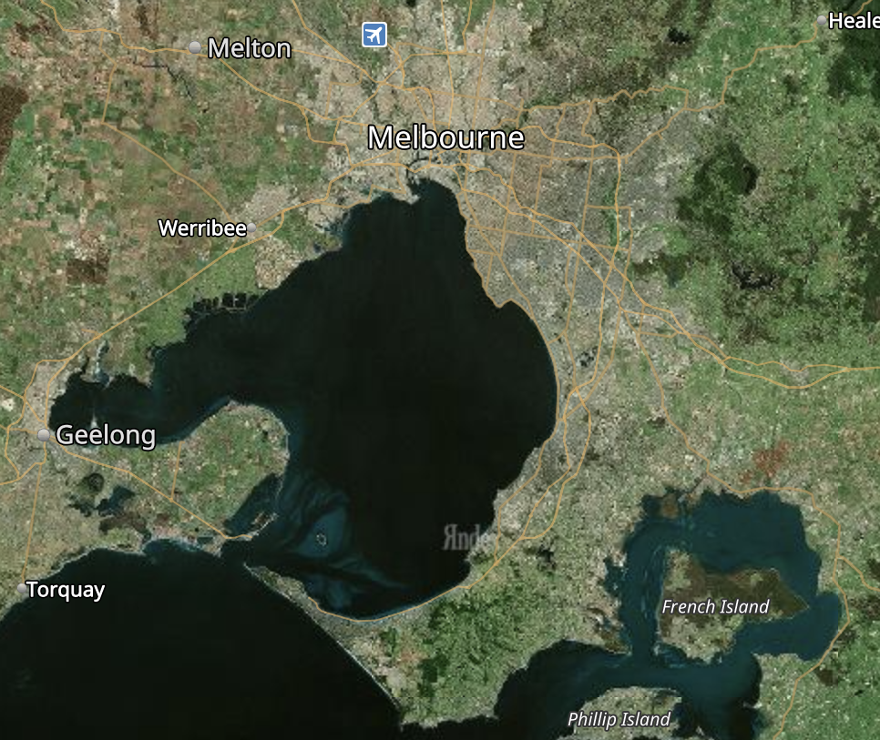
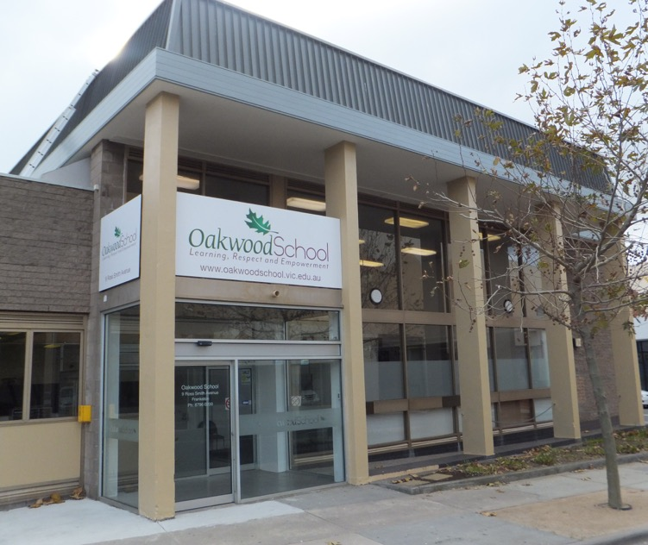
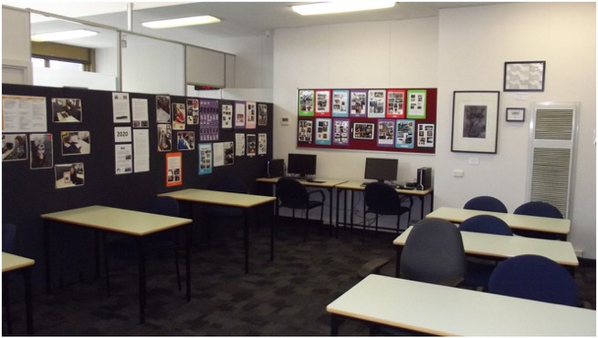
Oakwood School
was established to provide learning opportunities for students aged
10 to 18 who
have disengaged from school.
Sth Melb
Caulfield North
Noble Park North
Chelsea
Pakenham
Frankston
Mornington
Hastings
Rosebud

Slide 5
47%
7
MONTHS
1291
60%
STUDENTS SINCE 2011
FEMALE
ENROL 14/15 YO
MEDIAN DISENGAGEMENT
100% experiencing trauma
10%
11%
15%
465
ATSI
DISABILITY
OUT OF HOME CARE
CURRENT ENROLMENT
Learning and social difficulties

Slide 6
Oakwood School (according to “Lirata Consulting”)
‟
A deeply reflective, constantly evolving dynamic school with focused vision, exemplary practice and respectful, trusting relationships at its core.
A school where the espoused values and school policies are alive and in use at all levels and ongoing professional learning is central.
It is both peaceful and supportive, but also alive, fun and interesting.
„

Slide 7
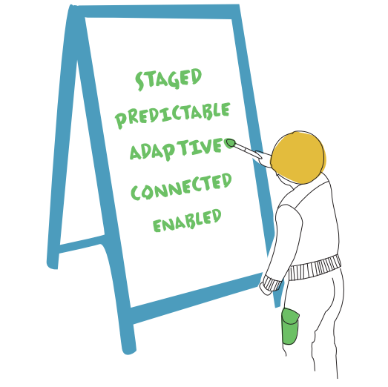
Making SPACE for learning - ACF
The capacity of traumatised children and young people to learn is significantly compromised.
Research into the neurobiology of
trauma suggests that under states of chronic physiological stress, the most complex and last-to-develop functions of the brain are switched off.

Slide 8
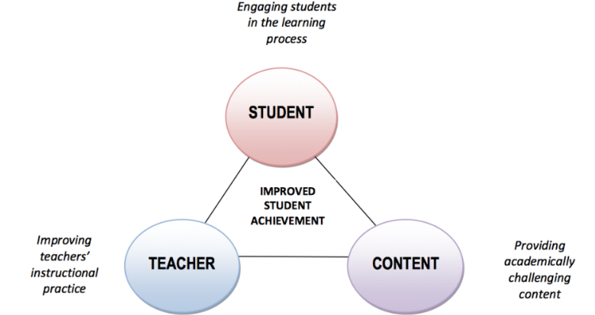
Instructional Core- Elmore
improve the teacher’s skills and knowledge, the students’ level of engagement and participation in learning, and the rigor of the content being taught.
Text
Text

Slide 9
Student Voice and Agency
Authentic student voice provides opportunities for students to collaborate and make decisions with adults around what and how they learn and how their learning is assessed.
Student agency refers to the level of autonomy and power that a student experiences in the learning environment. Agency gives students the power to direct and take responsibility for their learning, creating independent and self-regulating learners.
Student voice and agency are intrinsically linked.

Slide 11
Instructional Model elements… | Gradual Release Model | Metacognition
Generating Curiosity |  | PLAN | Ongoing Formative Assessment and use of HITS
Goal Setting
Activating Prior Knowledge
Intervention/New Information - Exploring Key Ideas | I DO | DO
Practice | WE DO
Application | YOU DO
Goal Review |  | REVIEW

Slide 12
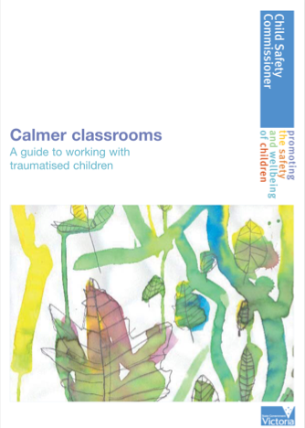
Both research and wisdom show us that regardless of the adversity they face, if a child can develop and maintain a positive attachment to school, and gain an enthusiasm for learning, they will do so much better in their lives.
The role of teachers in the lives of traumatised children cannot be underestimated.
Calmer Classrooms page iv, 2007

Slide 13
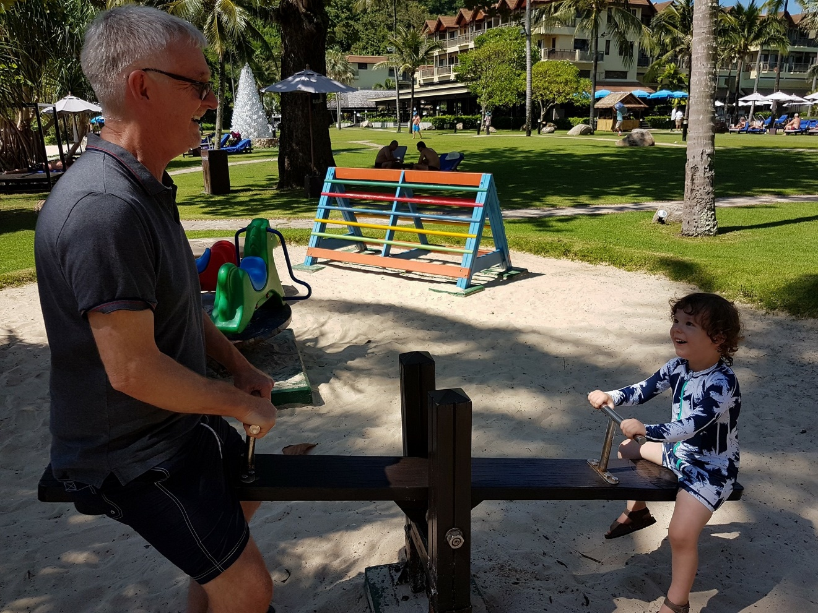
You’re lucky, Jack listens to you

